Slide 1
Welcome

Slide 2
Activity lifecycle

Slide 3
When Android lifecycle changes

Slide 4
When Android lifecycle changes
User action

Slide 5
When Android lifecycle changes
User action
Configuration

Slide 6
When Android lifecycle changes
User action
Configuration
Device rotation

Slide 7
When Android lifecycle changes
User action
Configuration
Device rotation
System action

Slide 8
Android lifecycle behavior

Slide 9
Android lifecycle behavior
Created (not visible yet)

Slide 10
Android lifecycle behavior
Created (not visible yet)
Started (visible, no interaction)

Slide 11
Android lifecycle behavior
Created (not visible yet)
Started (visible, no interaction)
Resume (visible, there is interaction)

Slide 12
Android lifecycle behavior
Created (not visible yet)
Started (visible, no interaction)
Resume (visible, there is interaction)
Paused (Partially invisible)

Slide 13
Android lifecycle behavior
Created (not visible yet)
Started (visible, no interaction)
Resume (visible, there is interaction)
Paused (partially invisible)
Stopped (hidden, stored in the memory)

Slide 14
Android lifecycle behavior
Created (not visible yet)
Started (visible, no interaction)
Resume (visible, there is interaction)
Paused (partially invisible)
Stopped (hidden, stored in the memory)
Destroyed (nothing)

Slide 15
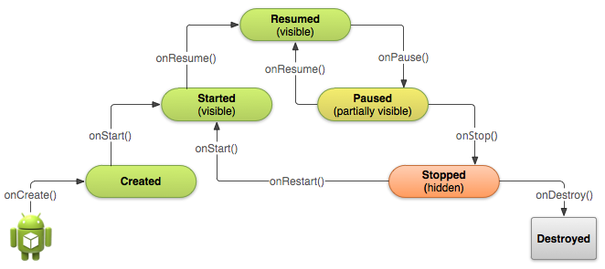
Android lifecycle behavior

Slide 16
Intent

Slide 17

Name: Intent
Job: Postman

Slide 18

Intent
A

Slide 19
Intent
A

Slide 20
Intent
A
Address
Car

Slide 21

Intent
A

Slide 22
Intent
A
B

Slide 23
Intent
A
B

Slide 24
Intent
A
B
From > To

Slide 25
Intent
A
B
From > To
Intent From > To

Slide 26
Intent
A
B
From > To
Intent From > To
Intent From , To

Slide 27
Intent
A
B
From > To
Intent From > To
Intent From , To
Intent ( From , To )

Slide 28
Intent ( From , To )

Slide 29
Intent ( From , To )
Intent (From , To )

Slide 30
Intent ( From , To )
Intent (From , To )
new Intent (From , To ) initialize a new intent object

Slide 31
Intent ( From , To )
Intent (From , To )
new Intent (From , To ) initialize a new intent object
new Intent (From , To )
store

Slide 32
Intent ( From , To )
Intent (From , To )
new Intent (From , To ) initialize a new intent object
new Intent (From , To )
store
anyname =
new Intent (From , To )

Slide 33
Intent ( From , To )
Intent (From , To )
new Intent (From , To ) initialize a new intent object
new Intent (From , To )
store
anyname =
new Intent (From , To )
Intent
anyname =
new Intent (From , To )

Slide 34
Intent ( From , To )
Intent (From , To )
new Intent (From , To ) initialize a new intent object
new Intent (From , To )
store
anyname =
new Intent (From , To )
Intent
anyname =
new Intent (From , To )
Intent
anyname =
new Intent (From , To )

Slide 35
Intent
anyname =
new Intent (From , To )

Slide 36

Intent
anyname =
new Intent (From , To )
Intent

Slide 37

Intent
anyname =
new Intent (From , To )
= startActivity()
anyname

Slide 38
Intent
anyname =
new Intent (From , To )
= startActivity()
anyname
startActivity( anyname )

Slide 39
Intent
anyname =
new Intent (From , To )
= startActivity()
anyname
startActivity( anyname )
Intent
anyname =
new Intent (From , To )
startActivity( anyname )

Slide 40
Intent
anyname =
new Intent (From , To )
= startActivity()
anyname
startActivity( anyname )
Intent
anyname =
new Intent (From , To )
startActivity( anyname )
Intent
anyname =
new Intent (A , B )
startActivity( anyname )

Slide 41
Intent
anyname =
new Intent (A , B )
startActivity( anyname )

Slide 42
Intent
anyname =
new Intent (A , B )
/**
*
* Block of code
*
/
startActivity( anyname )

Slide 43
Implicit Intent

Slide 44
Weekly Project
Support Session

Slide 45
Thanks

